Slide 1


Organizational Behavior
(MGT-502)
Lecture-13

Slide 2
Summary of
Lecture-12

Slide 3
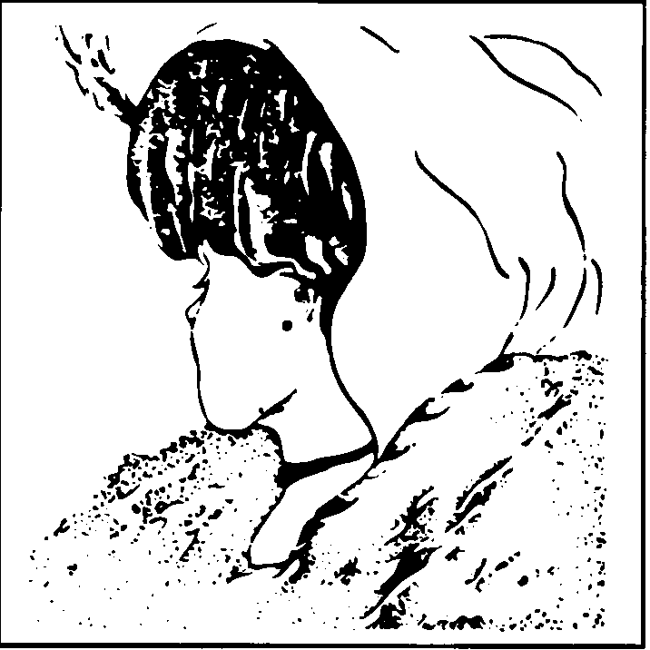
Perception

Slide 4
Factors Influencing Perception
The Perceiver
The Target
The Situation

Slide 5
Attribution
The Process through which individuals attempt to determine the causes of others behavior

Slide 6
Fundamental Attribution Error
The tendency to attribute others’ actions to internal causes (e.g their traits) while largely ignoring external factors that also may have influenced their behavior.

Slide 7
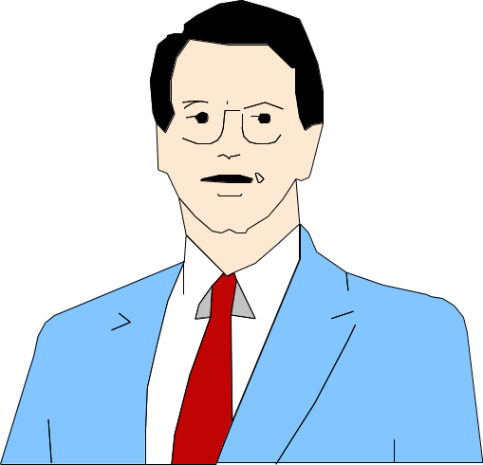

Impression Management
Self-presentation
Is the process by which people attempt to manage or control the perceptions other form of them.

Slide 8
Perception & Decision Making

Slide 9
Rational Decision-Making Model
A decision-making model that describes how individuals should behave in order to maximize some outcomes.

Slide 10
Alternatives to
Rational Decision- Making
Bounded Rationality
Intuitive Decision-making
Decision-Making by Objection
The Garbage Can Model

Slide 11
A Model of Bounded Rationality
Ascertain
the Need
for a Decision
Select
Criteria
Identify a
Limited Set
of Alternatives
Compare
Alternatives
Against Criteria
Select the
First “Good
Enough” Choice
Yes
Simplify
the Problem
Expand
Search for
Alternatives
A “Satisficing”
Alternative
Exists
No

Slide 12
Intuitive Decision Making
High uncertainty levels
Little precedent
Hard to predictable variables
Limited facts
Unclear sense of direction
Analytical data is of little use
Several plausible alternatives
Time constraints

Slide 13
Decision-Style Model
High
Analytical
Conceptual
Tolerance for Ambiguity
Directive
Behavioral
Low
Rational
Intuitive
Way of Thinking

Slide 14
Criteria of Decision Effectiveness
Quality
Timeliness
Acceptance
Ethical Appropriateness

Slide 15
Types of Managerial Decisions
Programmed vs. Nonprogrammed
Strategic vs. Operational
Top-Down vs. Worker-Empowered

Slide 16
Methods of Improving Decision Making in Organizations
Human-based Methods
Computer-based Methods
Brainstorming
Nominal Group Technique
Delphi Method

Slide 17
Today’s Topics

Slide 18
Motivation
A state of mind, desire, energy or interest that translates into action.

Slide 19
Motivation
  The inner drive that directs a person’s behavior toward goals.

Slide 20
Defining Motivation
The processes that account for an individual’s intensity, direction and persistence of effort toward attaining a goal.
Key Elements
Intensity: how hard a person tries
Direction: toward beneficial goal
Persistence: how long a person tries

Slide 21
Intensity is concerned with how hard a person tries. This is the element most of us focus on when we talk about motivation.
Direction is the orientation that benefits the organization.
Persistence is a measure of how long a person can maintain his/her effort. Motivated individuals stay with a task long enough to achieve their goal.

Slide 22
Why Do We Care?
Ability
PERFORMANCE
Motivation
Opportunity
Performance =
f (Ability, Motivation, Opportunity)
Notes:
Material pertinent to this illustration is found on pages 189-190.

Slide 23
The Motivation Process

Slide 24
Need
More money for
unexpected medical expenses
Goal-directed behavior
Ask for a raise
Work harder to gain a promotion
Look for a higher-paying job
Steal
Need Satisfaction
More money

Slide 25
Core Phases of the Motivational Process

Slide 26
1. Employee
Identifies
Needs
2. Employee
Searches for
Ways to Satisfy
These Needs
3. Employee
Selects Goal-
Directed
Behavior
5. Employee
Receives Either
Rewards or
Punishments
4. Employee
Performs
6. Employee
Reassesses Need
Deficiencies

Slide 27
Motivational Theories

Slide 28
Maslow’s Hierarchy of Needs

Slide 29
Maslow’s Hierarchy of Needs
Self-actualization needs
(self-development, realization)
Esteem needs
(self-esteem, recognition, status)
Social needs
(sense of belonging, love)
Safety needs
(security, protection)
Physiological needs
(hunger, thirst)

Slide 30
Basic assumptions
Once a need is satisfied, its role declines
Needs are complex, with multiple needs acting simultaneously
Lower level needs must be satiated before higher level needs are activated
More ways exist to satisfy higher level needs

Slide 31
Individual and environment influence employee behavior
Individuals decide behavior, although environment can place constraints
Individuals have different needs/goals
Decide among alternatives based on perception of behavior leading to desired outcome

Slide 32
Modified Maslow Model
Higher
Level
Social
Esteem
Self
Actualization
Lower
Level
Physiological and Safety

Slide 33
Alderfer’s ERG Theory
A three-level hierarchical need theory of motivation that allows for movement up and down the hierarchy.
Existence Needs
Relatedness Needs
Growth Needs

Slide 34
Alderfer’s ERG Model
Individuals have 3 basic needs
  Existence
  Relatedness
  Growth
Needs correspond to Maslow’s Hierarchy
Models differ in how needs are satisfied

Slide 35
ERG Theory
Existence
Relatedness
Growth
All needs are operative at one time

Slide 36

Theory X
Management view that assumes workers generally dislike work and must be forced to do their jobs.

Slide 37
Under Theory X, the four assumptions held by managers are:
Employees inherently dislike work and, whenever possible, will attempt to avoid it.
Since employees dislike work, they must be coerced, controlled, or threatened with punishment to achieve goals.
Employee will avoid responsibilities and seek formal direction whenever possible.

Slide 38

Theory Y
Management view that assumes workers like to work and under proper conditions, employees will seek responsibility to satisfy social, esteem, and self-actualization needs.

Slide 39
Under Theory Y, the assumptions:
Employees can view work as being as natural as rest or play.
People will exercise self-direction and self-control if they are committed to the objectives.
The average person can learn to accept, even seek, responsibility.
The ability to make innovative decisions is widely spread throughout the population and is not necessarily the sole responsibility of those in management positions.

Slide 40

Theory Z
A management philosophy that stresses employee participation in all aspects of company decision making.

Slide 41
Motivational Process
Forces acting on/within person that cause specific, goal-directed behavior
Work motivation  productivity
Management’s job is to channel employee energy to achieve organizational goals

Slide 42
Motivation
What is so difficult?
Motivation is the set of forces that causes people to engage in one behavior rather than some alternative behavior.

Slide 43
What “energizes” us?
Unsatisfied needs = deficiencies that a person experiences at any given time
“Energizers” – create tensions  feelings of unrest  make effort to reduce tensions
Goal – directed efforts – provide focus for energy release

Slide 44

Let’s stop it here

Slide 45
Summary

Slide 46
Motivation
A state of mind, desire, energy or interest that translates into action.

Slide 47
Why Do We Care?
Ability
PERFORMANCE
Motivation
Opportunity
Performance =
f (Ability, Motivation, Opportunity)
Notes:
Material pertinent to this illustration is found on pages 189-190.

Slide 48
Motivational Theories

Slide 49
Maslow’s Hierarchy of Needs

Slide 50
Alderfer’s ERG Theory
A three-level hierarchical need theory of motivation that allows for movement up and down the hierarchy.
Existence Needs
Relatedness Needs
Growth Needs

Slide 51
Theory X
Management view that assumes workers generally dislike work and must be forced to do their jobs.

Slide 52
Theory Y
Management view that assumes workers like to work and under proper conditions, employees will seek responsibility to satisfy social, esteem, and self-actualization needs.

Slide 53
Theory Z
A management philosophy that stresses employee participation in all aspects of company decision making.

Slide 54
Next….

Slide 55
Organizational Behavior
(MGT-502)
Lecture-13

